Slide 1
Intro to Geometric Algebra
Robin Kahlow

Slide 2
Outline
What is Geometric Algebra?
Applications
Geometric Algebra Introduction
Examples
Rotors
Automatic Differentiation
Software implementation (TFGA presentation)

Slide 3
What is Geometric Algebra?

Slide 4
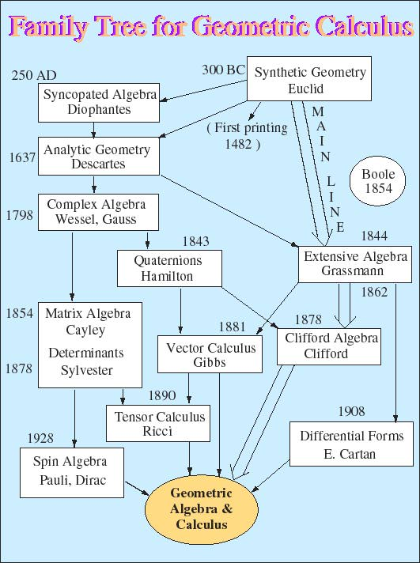
What is Geometric Algebra?
Mathematical framework
…Unifying traditionally distinct concepts
…Simplifying difficult concepts
…Understanding abstract concepts
…Generalizing existing concepts
Invented in 19th century by Grassmann, Clifford among others
Somewhat forgotten in favor of Vector algebra until later (~1960s by David Hestenes)
“Geometry without algebra is dumb! Algebra without geometry is blind!” - Hestenes
http://geocalc.clas.asu.edu/html/Evolution.html

Slide 5
2. Applications

Slide 6
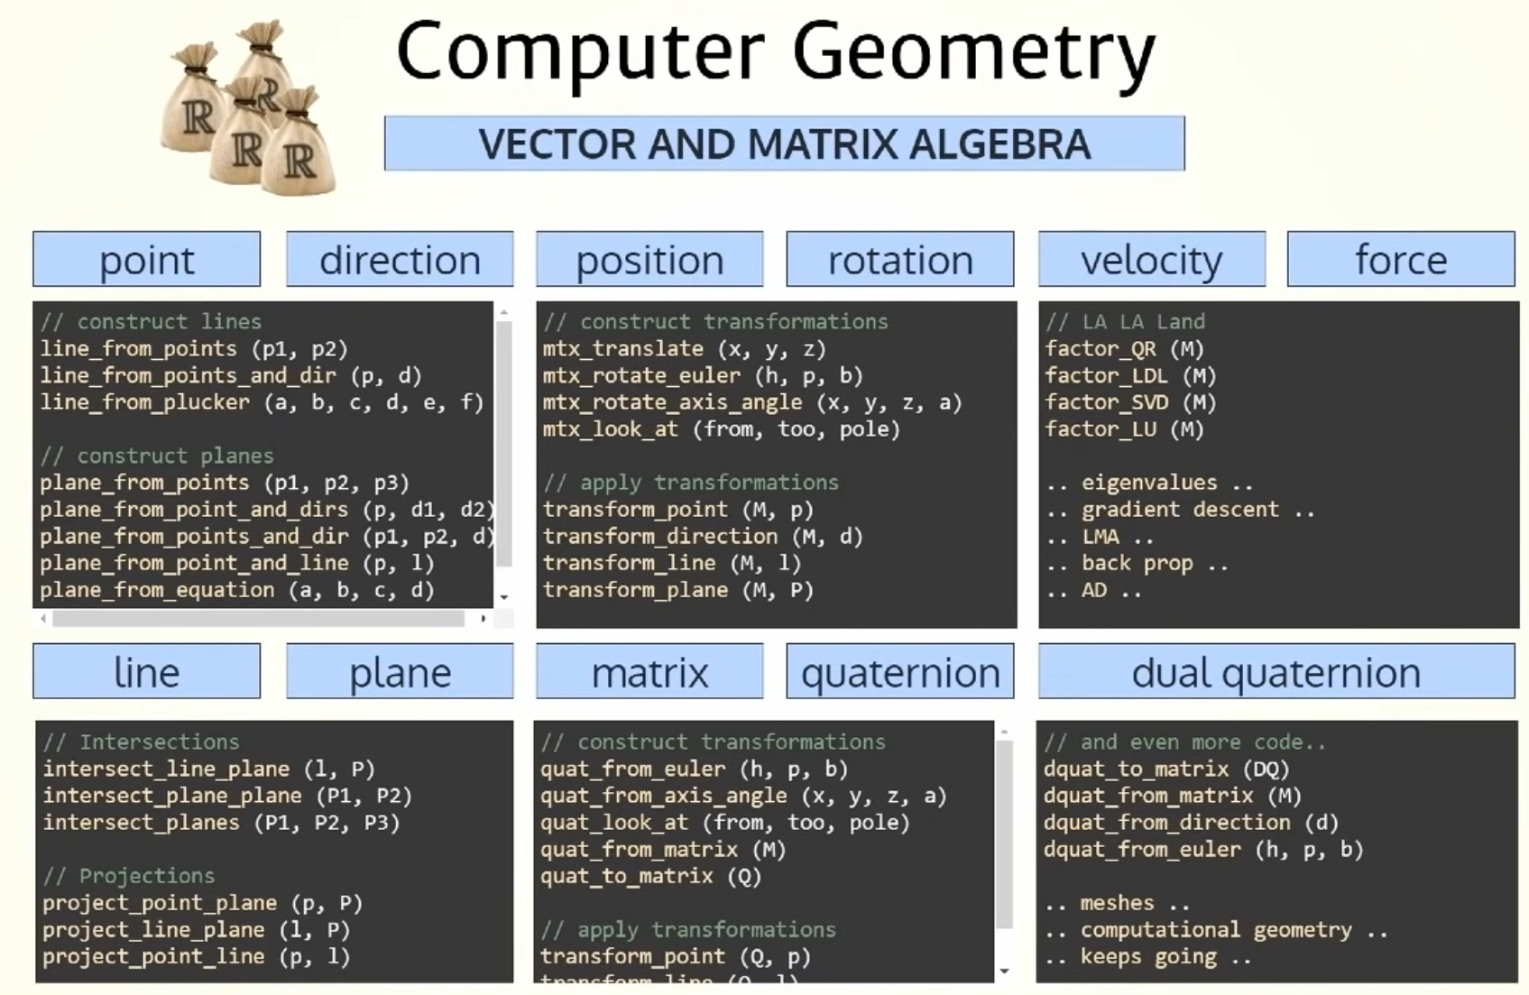
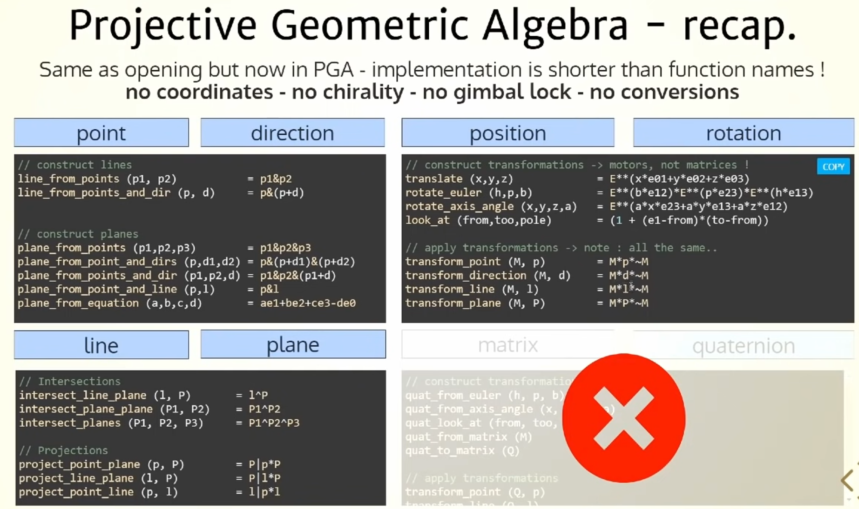
2. Applications - Computer Graphics
Geometric Algebra at SIGGRAPH 2019 - https://www.youtube.com/watch?v=tX4H_ctggYo
Traditional approach
(Projective) Geometric Algebra approach
Many types of objects: Vector, Matrix, Quaternion, Dual-Quaternion, …
Implementations require a lot of work
Only one type of object: Multivector
1-line implementations with simple GA operations

Slide 7
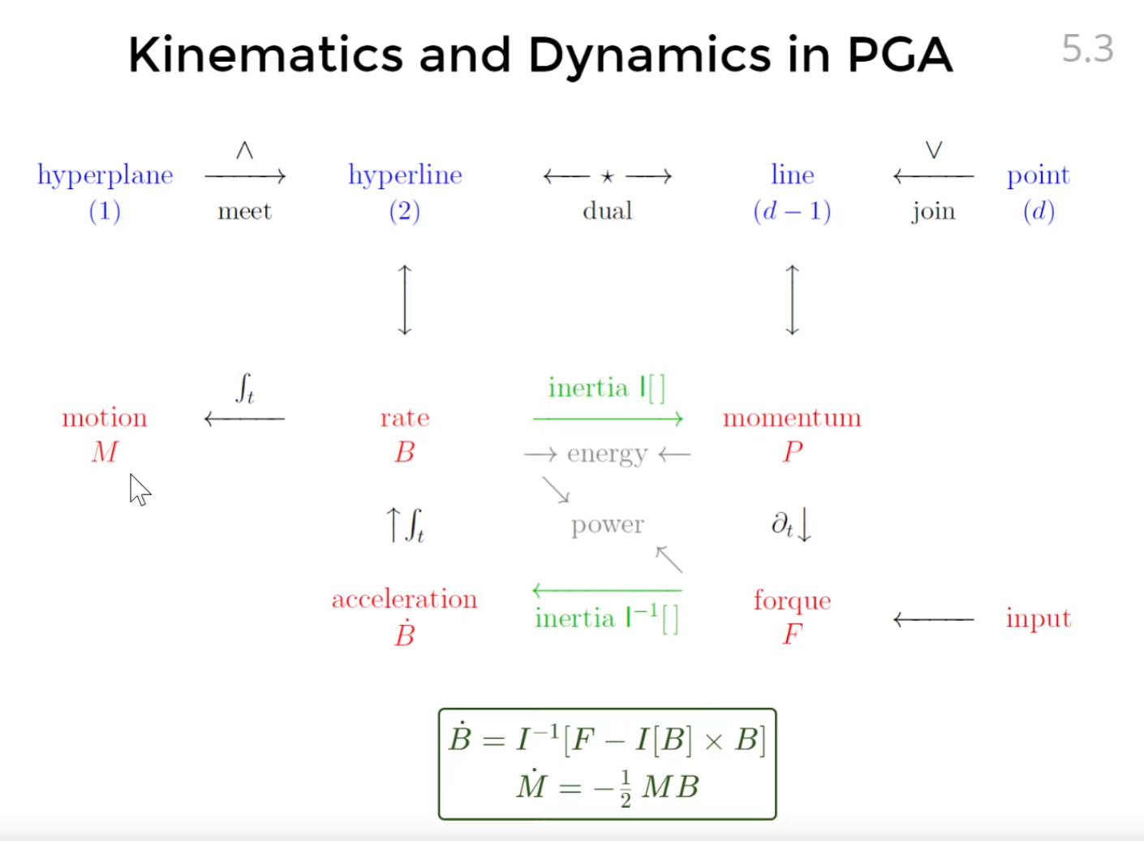
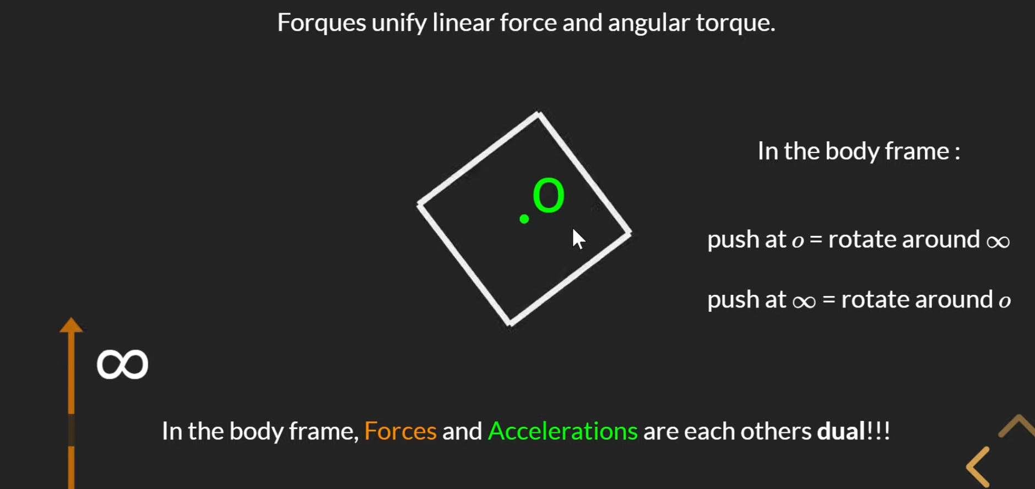
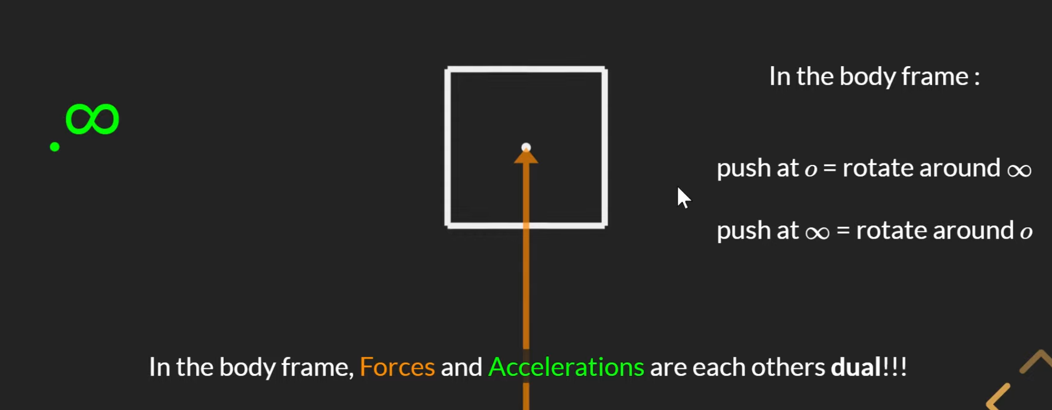
2. Applications - Physics - Classical Mechanics
Projective Geometric Algebra unifies rotation and translation
Force / Torque → “Forque”,
Gives insight on origin of Quantum Spin
Works in any dimension, equations stay the same (https://youtu.be/5R2sv9GCwz0?t=674)

Slide 8
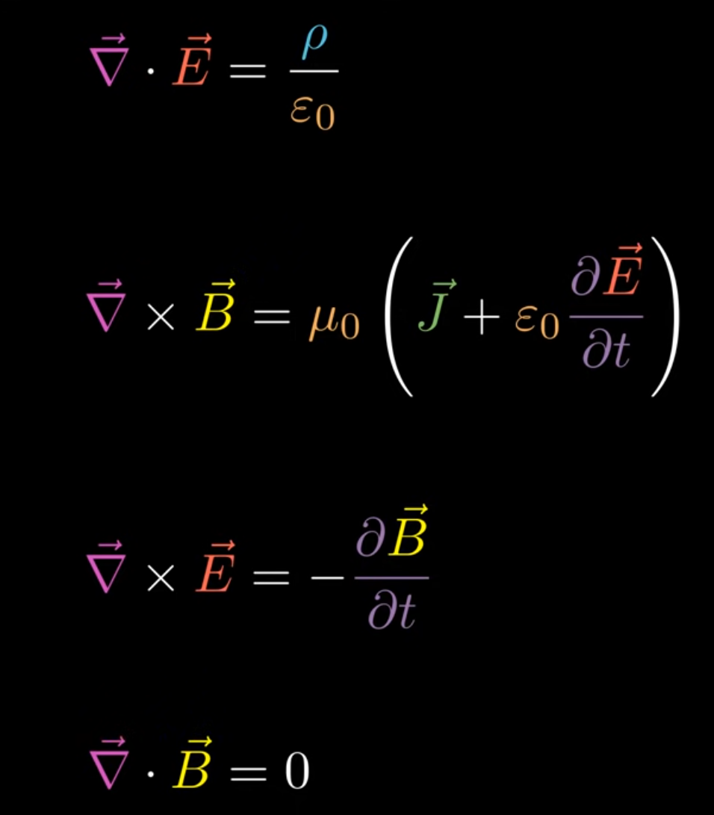
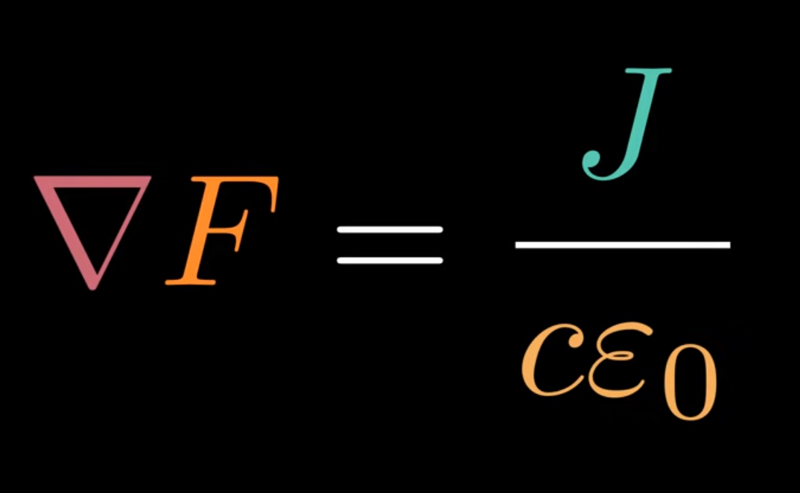
2. Applications - Physics - Electromagnetism
Electromagnetism
Maxwell’s 4 equations reduced to a single equation
Special Relativity calculations become much easier (eg. how a moving observer sees an E-field)
(F = E + I B)

Slide 9
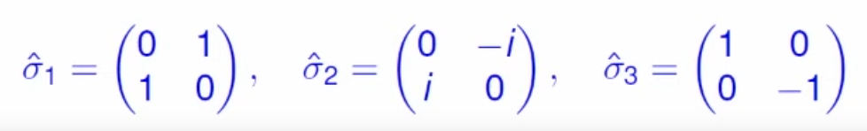
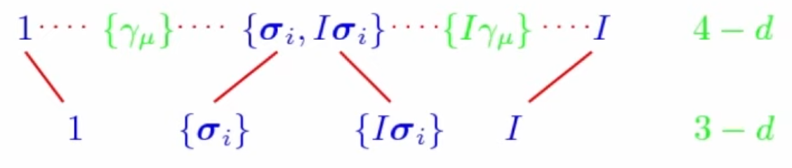
2. Applications - Physics - QM & GR
Quantum Mechanics - becomes more interpretable
4 Gamma matrices → 4 basis vectors of spacetime (not abstract!)
3 Pauli matrices → 3 basis vectors of space (and can be made from the 4 spacetime vectors!)
General Relativity (Gravity), two approaches:
Usual curved-space approach but with GA simplifying calculations
Gauge-Theory Gravity (https://arxiv.org/abs/gr-qc/0405033)
Space is flat, introduce gauge fields instead
Predictions almost all identical as ordinary approach
Lead to theoretical discovery of gravitational wave memory-effect

Slide 10
3. Geometric Algebra Introduction

Slide 11




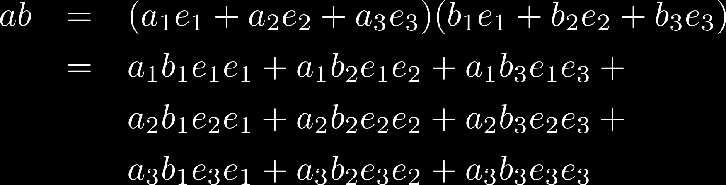
You could have invented Geometric Algebra
Multiply two vectors
Math teacher in high school / university: you can’t just multiply vectors
Dot product
Gives a scalar number that tells similarity between two vectors (cos angle)
Cross product
Gives a third vector that is orthogonal to the first two
Flipping order changes direction / sign
Only works in 3D
Geometric Algebra: why the hell not?
First rule:
Second rule:

Slide 12
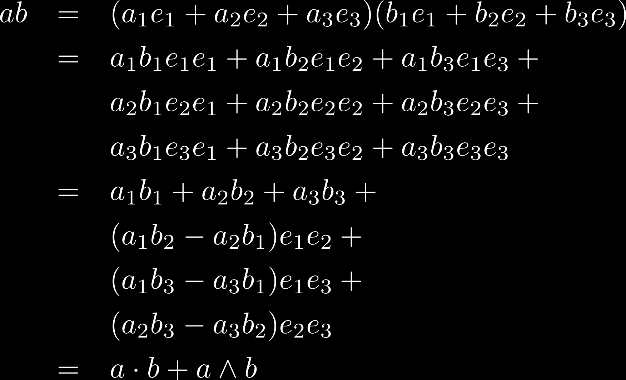
You could have invented Geometric Algebra
Multiply two vectors
Result has two different parts:
Scalar part from Dot product
“Bivector” part from “Wedge product”
Wedge product in 3D looks like Cross product
But: it’s a bivector and not a vector
Only in 3D:
For every plane, there is a vector orthogonal to it

Slide 13
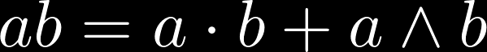
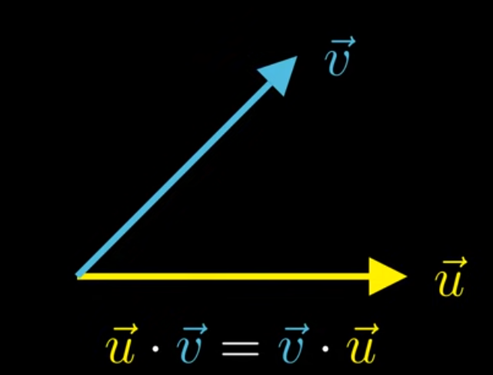
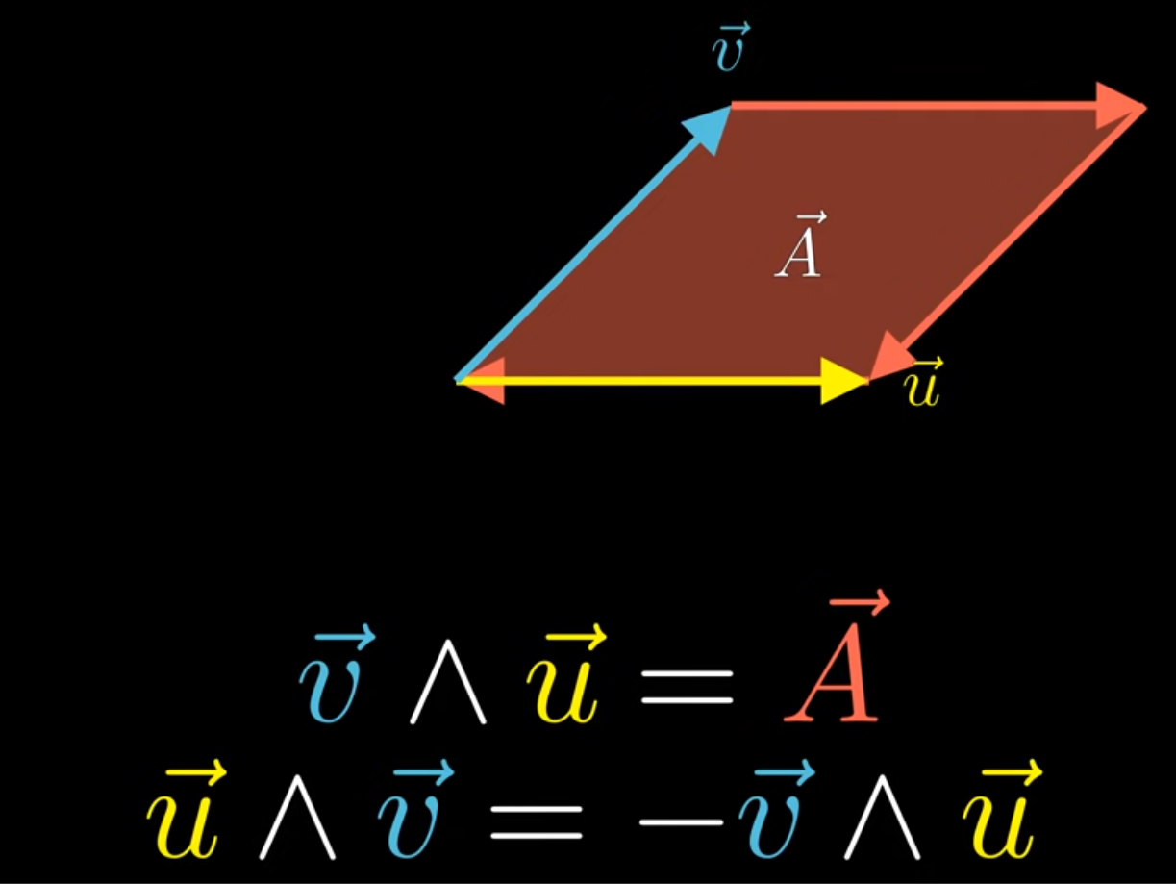
What does this mean geometrically?
Multiply two vectors
Often called Geometric Product
but really is just the ordinary product

Slide 14
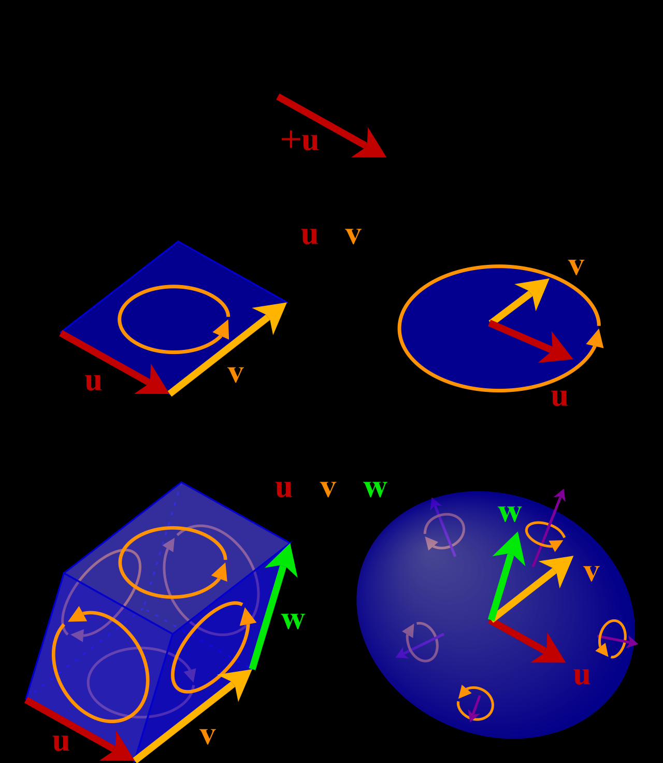



Geometry directly representable
Vectors: Line elements
Bivectors: Plane / Area elements
Trivectors: Volume elements

Slide 15
4. Examples
Rotors

Slide 16
4. Examples - Rotors
Multiplying two vectors gave us a bivector part (e_1 e_2)
Can be interpreted as plane area element
Let’s try to square a basis bivector
The basis bivector is like the Imaginary Unit from Complex Numbers!

Slide 17

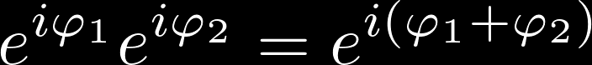
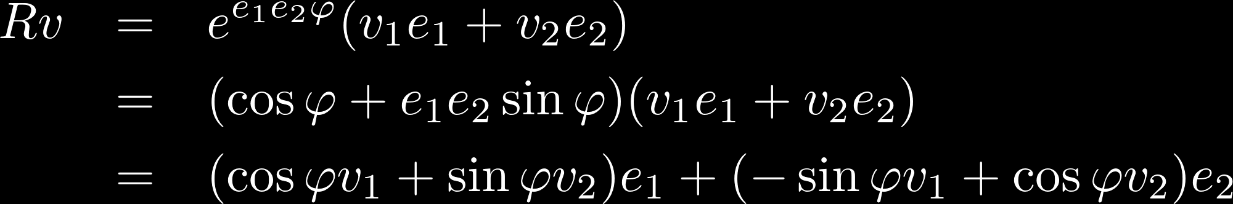
4. Examples - Rotors
Traditionally
A complex number is the sum of a real and imaginary part
Vectors and complex numbers are seen as separate concepts
Complex numbers can be used to represent and compose 2D rotation
In Geometric Algebra
Multiplying two vectors gives the Rotor rotating between them
Rotor has a real and a bivector part
We can multiply vectors and a scalar + bivector just fine
Rotates the vector:

Slide 18
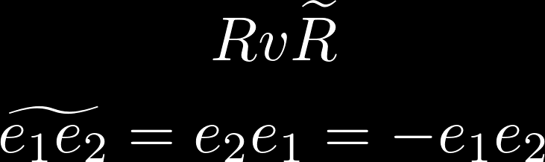
4. Examples - Rotors
In 3D, we have 3 basis bivectors → 3 Imaginary numbers → Quaternions
3 planes of rotation
Quaternions rotate in them just like Complex Numbers did in 2D in 1 plane of rotation
Formula for applying rotor in 2D to a vector (R v) was a special case, in general (any dim):
“Reverse”

Slide 19
4. Examples
Automatic Differentiation

Slide 20
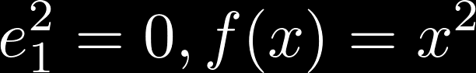
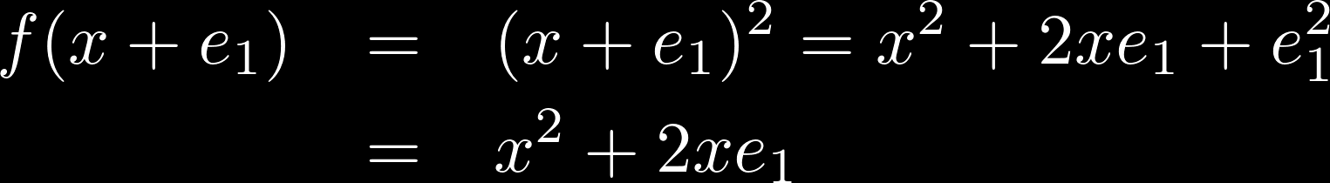
Example - Automatic Differentiation
So far we had basis vectors squaring to +1
Can also choose different number, eg. square to 0
Can be used for forward-mode automatic differentiation:
Can be extended to work for multiple inputs and higher order derivatives
More details in my writeup: https://discourse.bivector.net/t/automatic-differentiation/289

Slide 21
5. Software Implementation (TFGA Presentation)
https://tfgap.warlock.ai/#/6

Slide 22
More resources on Geometric Algebra
Online
Sudgy Lacmoe’s “A Swift Introduction to Geometric Algebra”: https://youtu.be/60z_hpEAtD8
Videos on Youtube channel Bivector: https://www.youtube.com/channel/UCZZ3MA6ChVTViq8ORmFfCPA
Geometric Algebra Discord community: https://discord.gg/vGY6pPk
Bivector website: https://bivector.net/
My own GA tutorials: https://geometricalgebratutorial.com/
Coffeeshop, lots of interactive GA examples: https://enkimute.github.io/ganja.js/examples/coffeeshop.html
Literature
Geometric Algebra for Physicists: https://www.cambridge.org/core/books/geometric-algebra-for-physicists/FB8D3ACB76AB3AB10BA7F27505925091
Geometric Algebra for Computer Science: https://geometricalgebra.org/
Geometric Algebra by Eric Chisolm: https://arxiv.org/abs/1205.5935
Linear and Geometric Algebra: http://www.faculty.luther.edu/~macdonal/laga/index.html

